Slide 1



Project 3: Immigrants in Georgia, USA
Project Objective
Geographic distribution of immigrants in Georgia, USA
Immigrants migrate to the U.S. for various reasons, such as reunite with family, flee persecution and violence in their home country and pursue new employment opportunities.
Understanding the immigrant populations in the state drives better policy decision to enable immigrants to achieve full potential, feel safe and contribute to state’s economic growth.
Meet the Team:
Yuanfeng Xu
Alexis Hernandez
Taib Diallo
Mary Jane Rafol

Slide 2
Project 3: Immigrants in Georgia, USA
Methodology
1
2
3
4
Identify Data Sources
Extract, Transfer and Load
Use Flask to export database into a JSON and to define routes
Use JavaScript to load JSON into HTML
US Immigrant Population by State migrationpolicy.org
SQLite
Route: 127.0.0.1:5000
D3 (d3js.org/)
Open Layers (openlayers.org/)
Observable (observablehq.com/)
5
Design the HTML

Slide 3




Project 3: Immigrants in Georgia, USA
Info Available to Users
Geographic distribution of immigrants in Georgia, USA
Demographic Info / Origin Distribution by County:
Asia
Europe
Africa
Central America
South America
Visualizations
Demographic info
Bar chart
Maps
Search Tool:
By Origin / Race
By Origin / Country
By County
Others
Geographic Concentration:
Maps

Slide 4
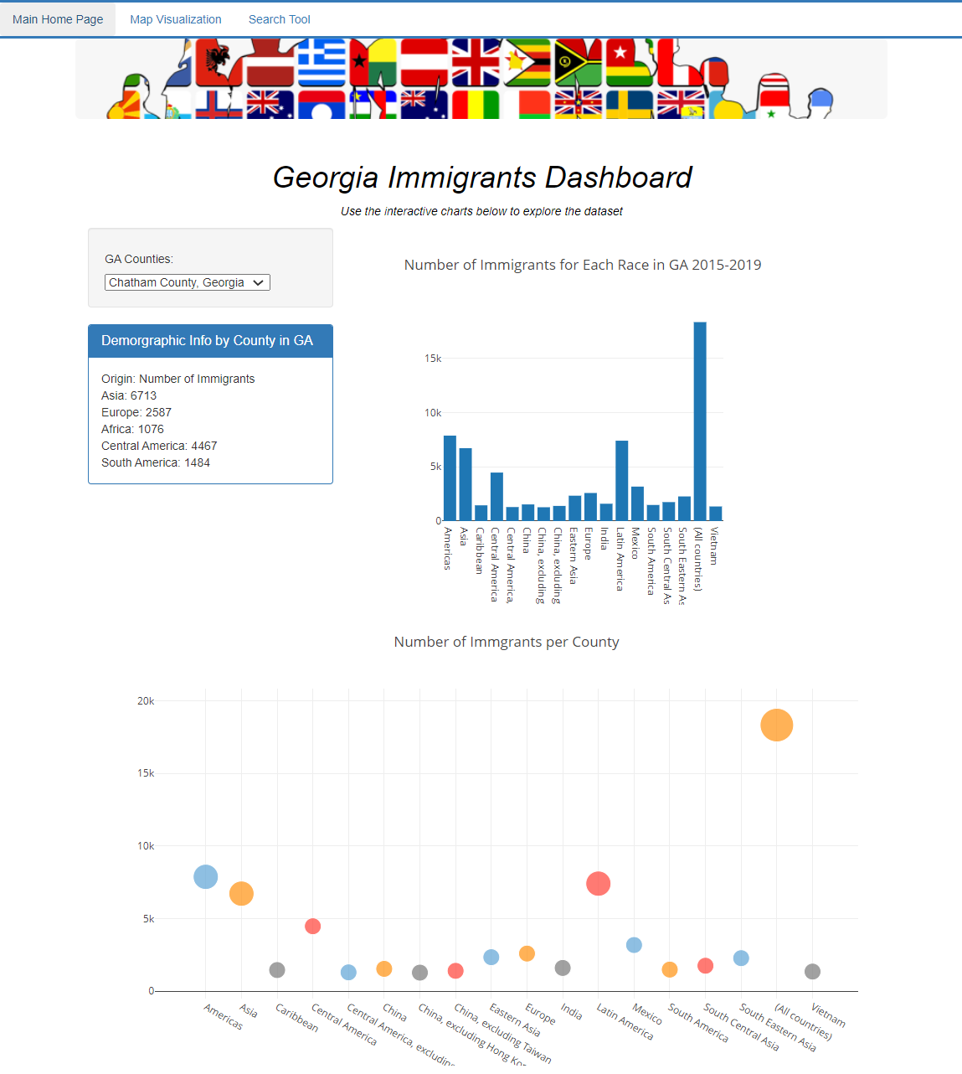
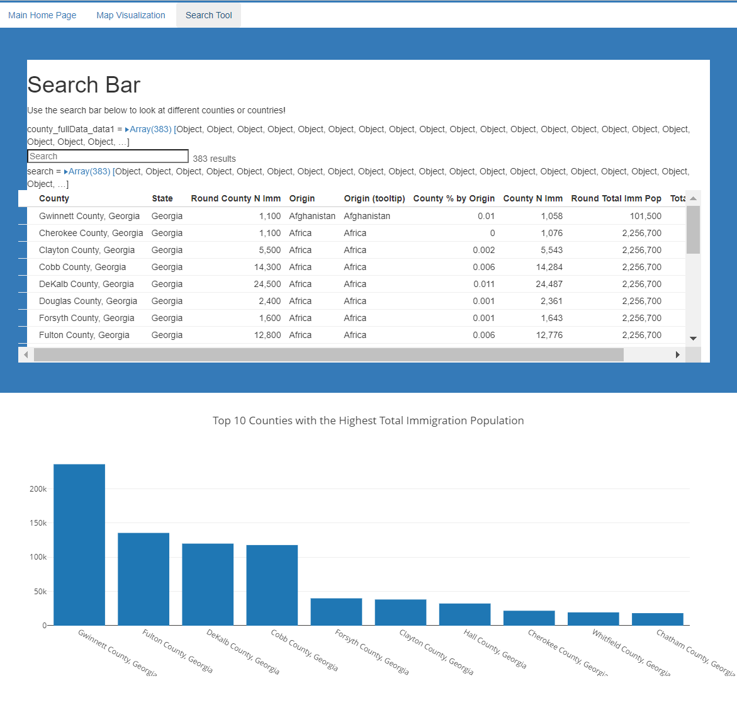
Project 3: Immigrants in Georgia, USA
Homepage
Search Tool

Slide 5
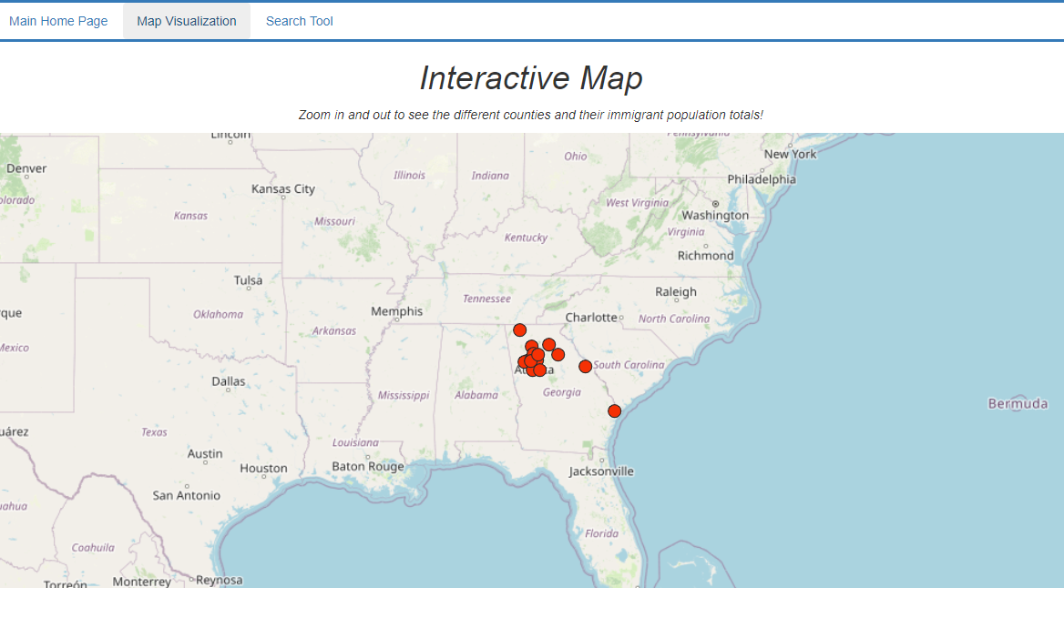
Project 3: Immigrants in Georgia, USA
Map

Slide 6
Project 3: Immigrants in Georgia, USA
Limitations
Geographic distribution of immigrants in Georgia, USA
The dataset is limited to the top 15 counties with highest immigrant population in the State of Georgia.
Given the fact that there undocumented immigrants, the dataset only accounts for documented immigrants captured in USCIS.
The dataset only shows cumulative data from 2015-2019 and does not break the population by year.
There are overlaps in population count by origin categories.

